Slide 1

Predicting used Car Price By using Various Predictors in MongoDB with help of Spark program
Project By :-
Tarun Yadav - C23037

Slide 2
Topics
Business Problem
EDA
Analysis Interpretation
Correlation Checking
Data Preparation
Pipeline creation and Data Normalization
Model Building
Output

Slide 3
Business Problem
Domain Chosen : Regression Problem
Why this domain is important ?
In this project, the objective is to predict the selling price of a used car using various predictors, including transmission, fuel type, car name, owner, and manufacturing year. The target variable is the car selling price.
What kind of impact this domain has?
This project will help to predict Cars price with help of Linear Regression Model.

Slide 4
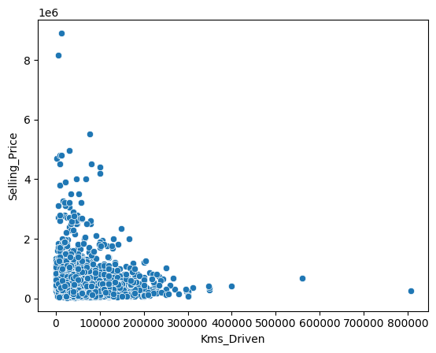
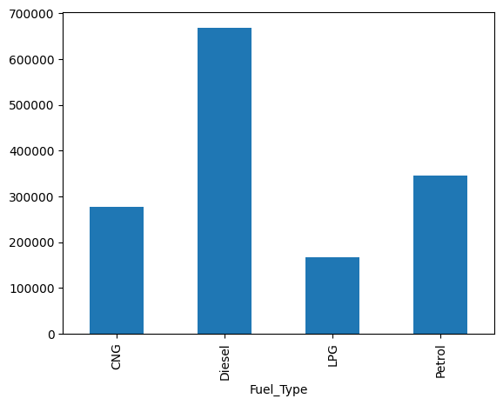
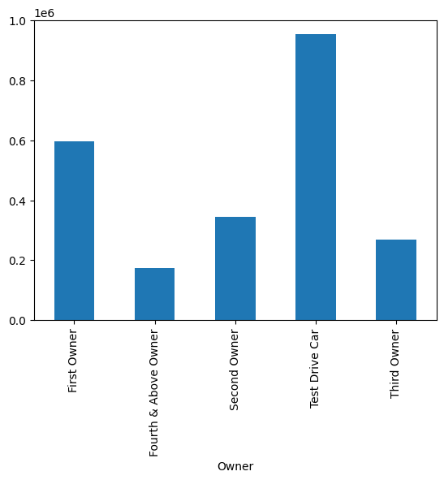
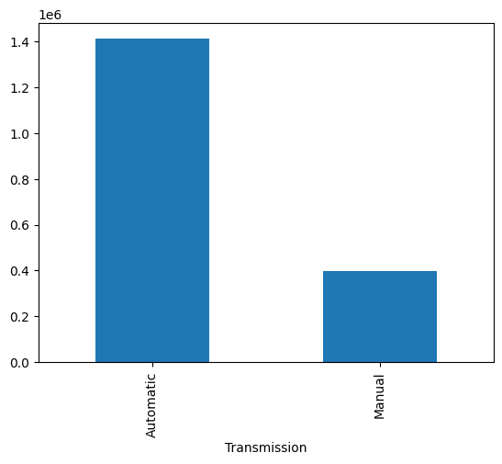
Exploratory Data Analysis
Using data visualization techniques such as charts and plots, perform both univariate and multivariate analysis during the exploratory data analysis (EDA) phase to gain valuable insights from the data.

Slide 5
Analysis Interpretation
From the above bivariate analysis we can understand that as more kms driven by cars the selling piece is tend to decrease.
The diesel type cars has highest selling price followed by petrol, CNG and LPG being the least.
The test car type is highest selling price followed by 1st owner, 2nd owner, 3rd owner and 4th owner being the least.
Automatic cars have highest selling price followed by manual.

Slide 6
Correlation checking
In the Correlation checking, we get
a> Kms Driven and Selling Price → -0.19
Which implies a negative correlation between Kms driven and selling price means as with more kms driven the selling price is tend to decrease.
b> Year and Selling Price → -0.41
Which implies a negative correlation between year and selling price means as with more no of year the selling price of the car is tend to decrease.

Slide 7
Data Preparation
Dummy Variable Creation
1) Convert Categorical to numerical columns
We use One hot encoder to convert Categorical column to numerical column
2) Using of String Indexer
This class is used to encode categorical variables, such as the "Seller_Type" column in the dataset.
After these operations, the new_data DataFrame will contain an additional column called "seller_type_indexer" that contains the indexed values representing the original categorical values from the "Seller_Type" column.
2) Dropping unnecessary columns
Next we drop unnecessary categorical columns as we already make indexer and vector columns for each categorical columns.

Slide 8
Pipeline Creation and Normalizing the data
Creation of Pipeline Stages
Defines a pipeline with two stages: a type indexer and a type encoder Type_indexer and Type_encoder transformers are used to preprocess the dataset.
Finally, the fit() method is called on the pipeline object with the new_data dataset as input.
This trains the pipeline on the data and returns a fitted pipeline (pipeline_model) that can be used to transform new data.
Standard Scaler
To Scale the features in the same range we use standard scaler which scales each value in 0 to 1 range.

Slide 9
Model Building
Train-Test Split-
Splitting a dataset (scaled_df) into training and test datasets using the randomSplit() method.
takes two arguments: weights and seed. The weights argument specifies the relative sizes of the resulting datasets, while the seed argument is an optional parameter used to specify a seed value for reproducibility..
the training dataset should have 70% of the data, and the test dataset should have 30% of the data. The seed argument is set to 1234.
The training Dataset Count: 3098 and the Test Dataset Count: 1236.

Slide 10
Output
Fit the training data in linear regression model and transform the test data using with linear regression model and take it into prediction.
Calculate the linear model coefficients and intercept for model interpretation, model prediction and model evaluation purpose.
3. The r square we get as 0.45 which is not a good fit for the model and further inspection is needed to evaluate it more.

Slide 11




